Slide 1
an International CBSE Finger Print School
Coimbatore
SUBJECT NAME - 041 MATHEMATICS
GRADE-XII
UNIT – 6
TOPIC – APPLICATION OF DERIVATIVES

Slide 2
Applications of Derivatives
RATE OF CHANGE OF QUANTITIES

Slide 3
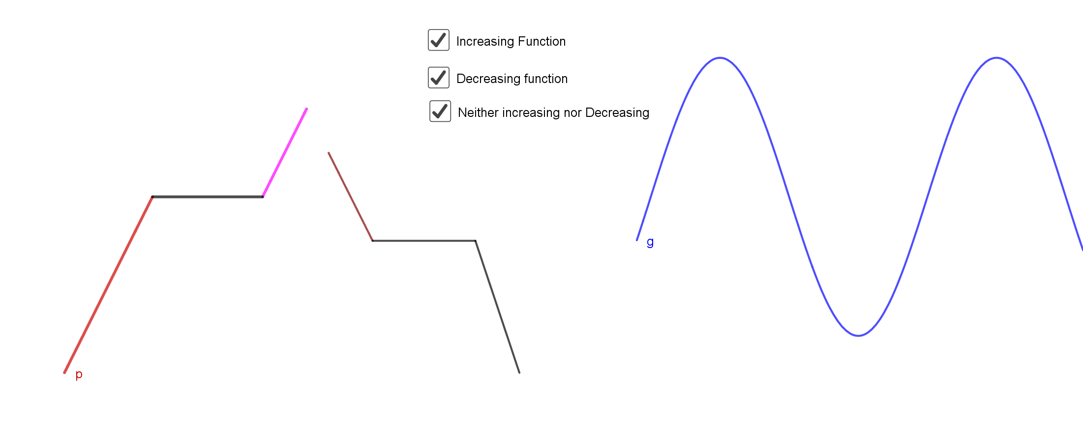
Increasing and Decreasing Functions
Strictly Increasing Function:
Strictly Decreasing Function:

Slide 4
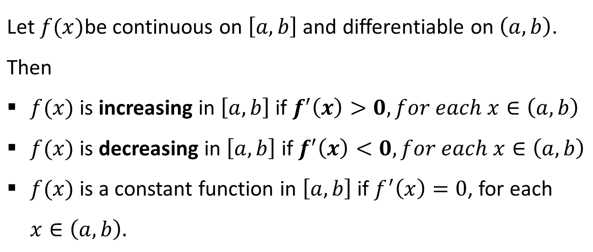
Theorem

Slide 5
First Derivative Test for Local Maxima and Minima
Let f be a function defined on an open interval I. Let f be continuous at a critical point c in I. Then
If f ′(x) changes sign from positive to negative as x increases through c,
i.e., if f ′(x) > 0 at every point sufficiently close to and to the left of c, and f ′(x) < 0 at every point sufficiently close to and to the right of c, then c is a point of local maxima.
(ii) If f ′(x) changes sign from negative to positive as x increases through c,
i.e., if f ′(x) < 0 at every point sufficiently close to and to the left of c, and f ′(x) > 0 at every point sufficiently close to and to the right of c, then c is a point of local minima.

Slide 6
(iii) If f ′(x) does not change sign as x increases through c, then c is neither a point of local maxima nor a point of local minima. In fact, such a point is called point of inflection
Second Derivative Test
Let f be a function defined on an interval I and c ∈ I. Let f be twice differentiable at c. Then
(i) x = c is a point of local maxima if f ′(c) = 0 and f ″(c) < 0
The value f (c) is local maximum value of f .
(ii) x = c is a point of local minima if f ′(c) = 0 and f ″(c) > 0
In this case, f (c) is local minimum value of f .
(iii) The test fails if f ′(c) = 0 and f ″(c) = 0.

Slide 7
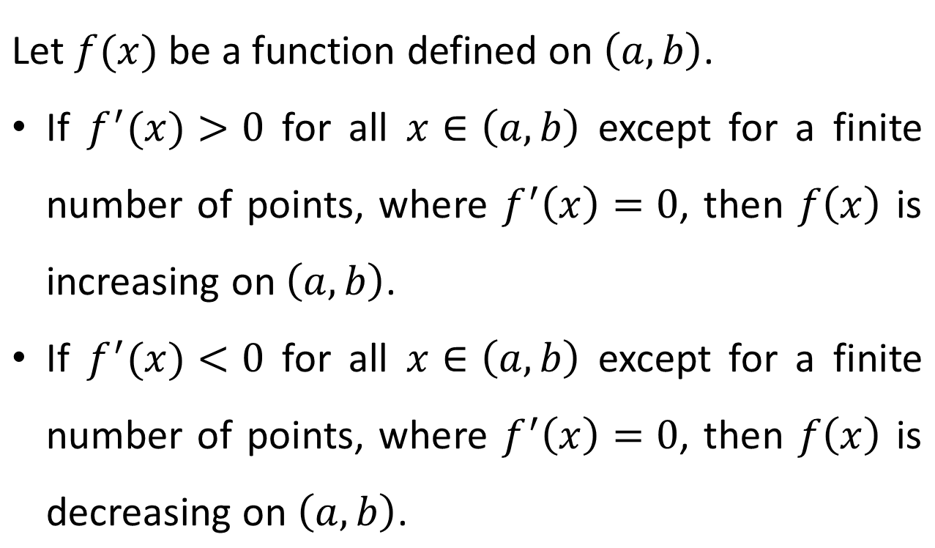
Corollary

Slide 8
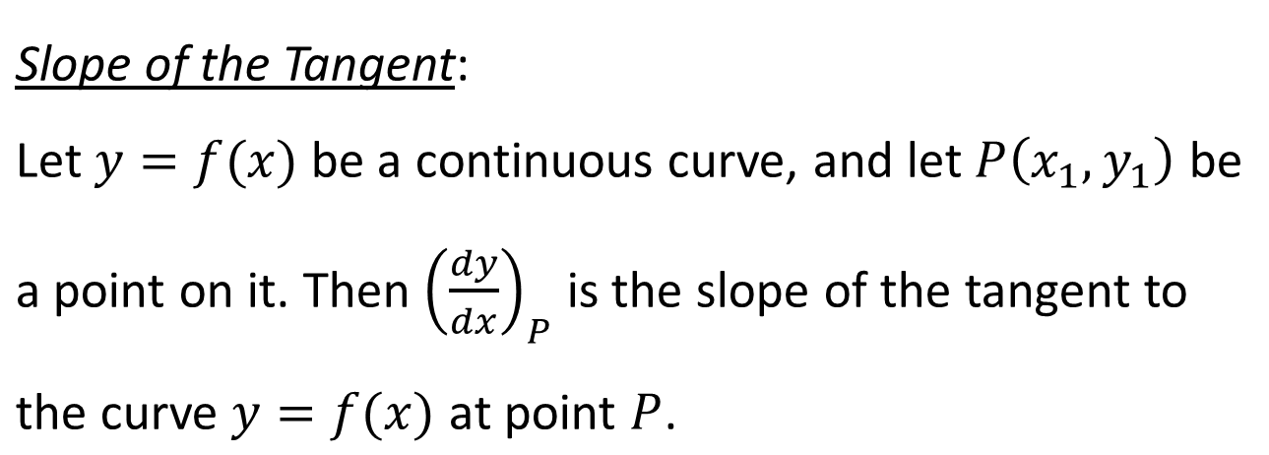
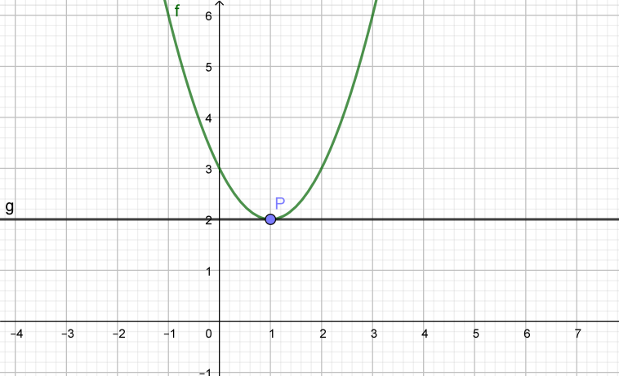
TANGENTS AND NORMALS
Slopes of Tangent and Normal
Note:

Slide 9
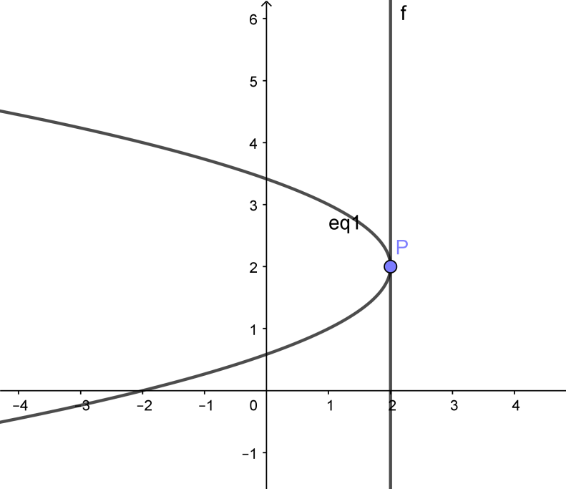
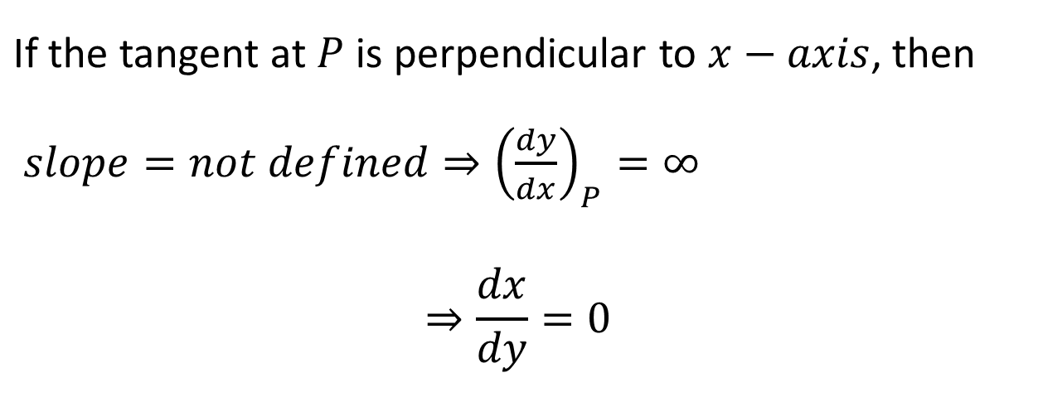
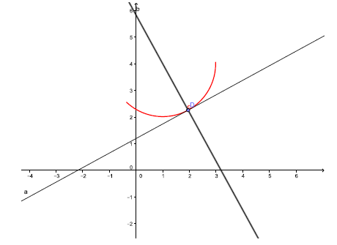
Slope of the Normal:

Slide 10
Equation of Tangent
Equation of Normal

Slide 11
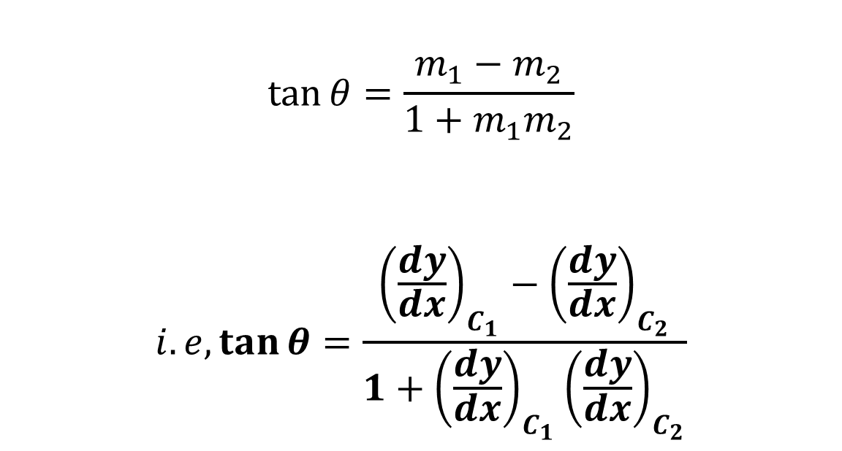
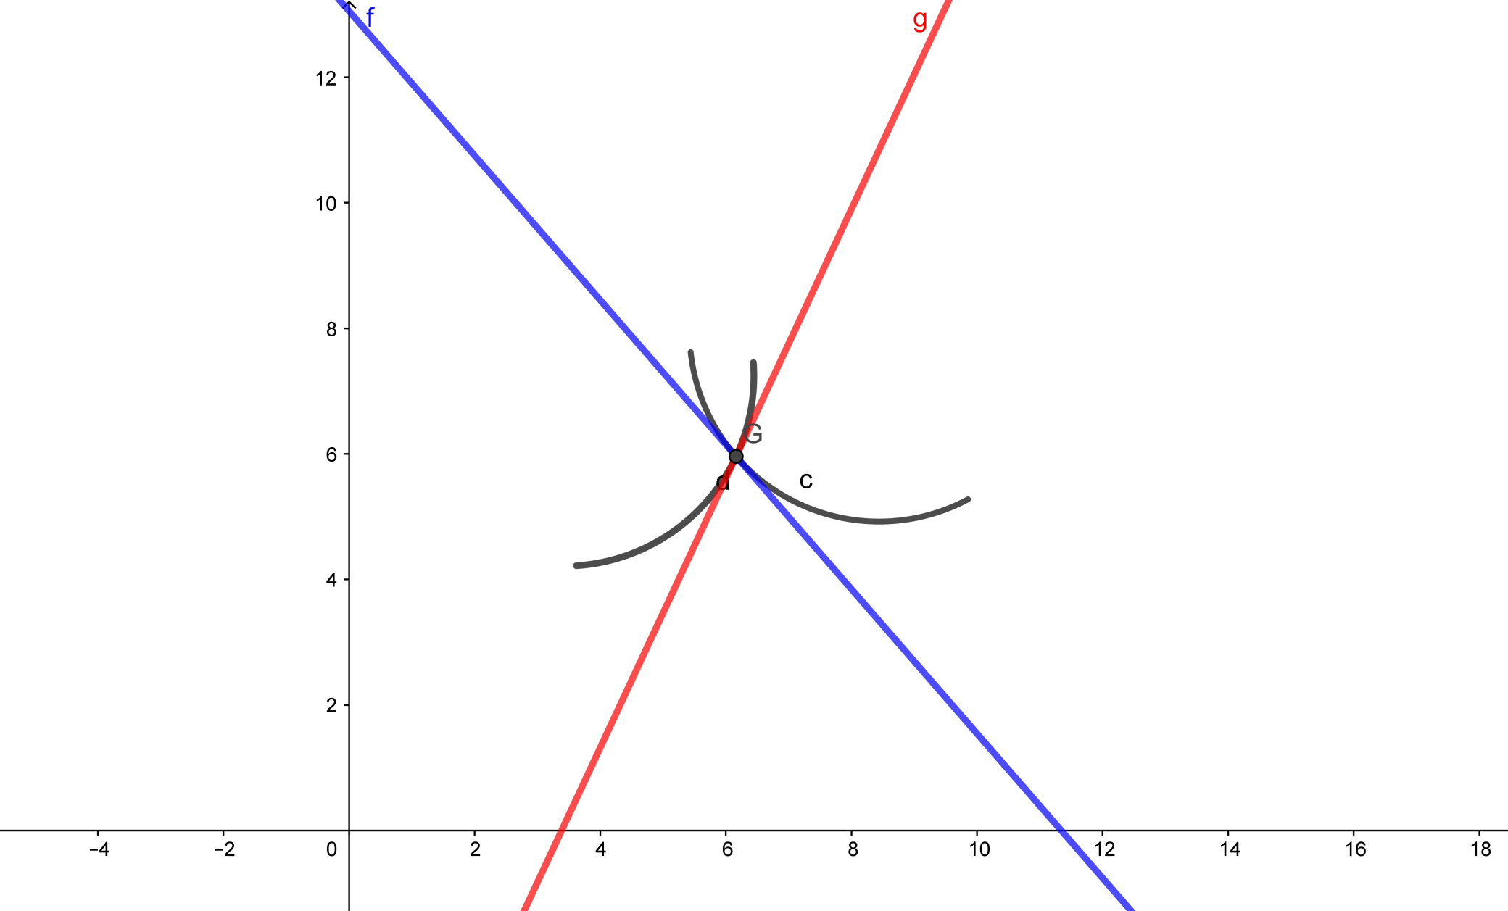
Angle of Intersection of Two Curves
Angle of intersection of two curves is the angle between the tangents at their point of intersection.

Slide 12
Orthogonal Curves:
If the angle of intersection of two curves is a right angle, the two curves are said to intersect orthogonally and the curves are called orthogonal curves.

Slide 13
Questions:
An edge of a variable cube is increasing at the rate of 3 cm/s. How fast is the volume of the cube increasing when the edge is 10 cm long?
Find the values of x for which y = [x(x – 2)]² is an increasing function.
Find local maximum and local minimum values of the function f given by f (x) = 3x⁴ + 4x³ – 12x² + 12
Find the absolute maximum and minimum values of a function f given by f (x) = 2x³ – 15x² + 36x +1 on the interval [1, 5].

Slide 14
References
https://d2cyt36b7wnvt9.cloudfront.net/exams/wp-content/uploads/2019/12/06154049/Maths_Ch-062.pdf
https://www.teachoo.com/subjects/cbse-maths/class-12th/ch6-12th-application-of-derivatives/
https://www.selfstudys.com/books/ncert-notes/english/class-12th/maths/chapter-6-application-of-derivative/41308
https://www.slideshare.net/iramkhan66/applications-of-derivatives-56443012
https://www.powershow.com/viewfl/1d5102-ZDc1Z/Application_of_Derivatives_powerpoint_ppt_presentation

